Slide 1
Chapter 2.8 Creating High-Quality Code
CCSW 325 (Software Construction)
Notes:
Last Update: 22/8/2019
Version 1.0

Slide 2
Outline
High Quality Routines (Part 2 of 3)
Good Routine Names
How Long Can a Routine Be?
How to Use Routine Parameters?

Slide 3
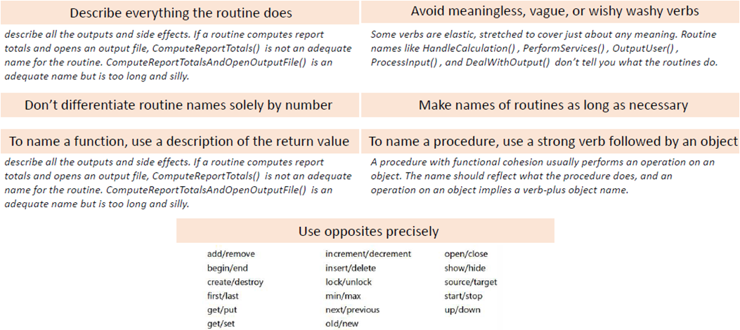
Good Routine Names
A good name for a routine clearly describes everything the routine does

Slide 4
How Long Can a Routine Be?
The theoretical best maximum length is often described as one screen or one or two pages of program listing, approximately 50 to 150 lines. In this spirit, IBM once limited routines to 50 lines, and TRW limited them to two pages (McCabe 1976)
A large percentage of routines in object-oriented programs will be accessor routines, which will be very short. From time to time, a complex algorithm will lead to a longer routine, and in those circumstances, the routine should be allowed to grow organically up to 100–200 lines (A line is a non comment, nonblank line of source code).

Slide 5
How to Use Routine Parameters?
Interfaces between routines are some of the most error-prone areas of a program
39 percent of all errors were internal interface errors—errors in communication between routines.

Slide 6
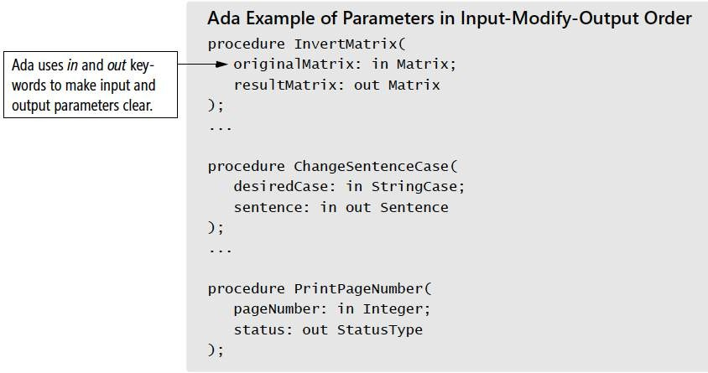
How to use Routine Parameters?
Put parameters in input-modify-output order
Instead of ordering parameters randomly or alphabetically, list the parameters that are input-only first, input-and-output second, and output-only third

Slide 7
How to Use Routine Parameters?
Use all the parameters
If you pass a parameter to a routine, use it. If you aren’t using it, remove the parameter from the routine interface.
Unused parameters are correlated with an increased error rate. In one study, 46 percent of routines with no unused variables had no errors, and only 17 to 29 percent of routines with more than one unreferenced variable had no errors (Card, Church, and Agresti1986).

Slide 8
How to Use Routine Parameters?
Put status or error variables last
By convention, status variables and variables that indicate an error has occurred go last in the parameter list. They are incidental to the main purpose of the routine, and they are output-only parameters, so it’s a sensible convention.

Slide 9
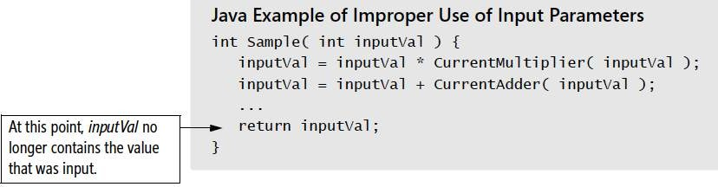
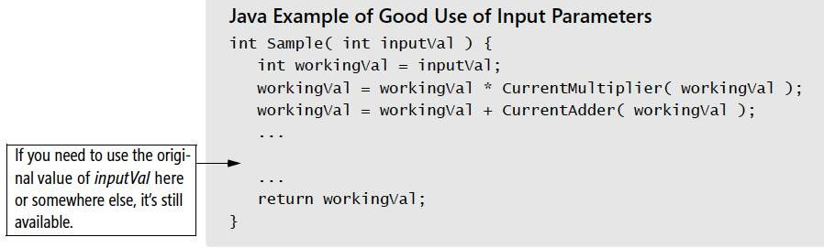
How to Use Routine Parameters?
Don’t use routine parameters as working variables
It’s dangerous to use the parameters passed to a routine as working variables. Use local variables instead.

Slide 10
How to Use Routine Parameters?
Make sure actual parameters match formal parameters
Formal parameters, also known as “dummy parameters,” are the variables declared in a routine definition. Actual parameters are the variables, constants, or expressions used in the actual routine calls.
A common mistake is to put the wrong type of variable in a routine call

Slide 11

How to Use Routine Parameters?
Limit the number of a routine’s parameters to about seven
Seven is a magic number for people’s comprehension

Slide 12
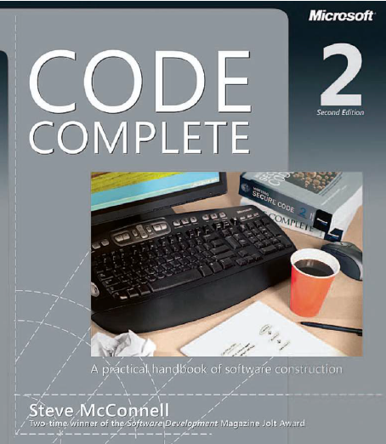
Reading
Code Complete: A Practical Handbook of Software Construction, 2nd Edition, Steve McConnell.
Chapter 7

Slide 13

Any questions? ​
Please feel free to raise your hands and ask.

